Slide 1
FIT1055: IT professional practice and Ethics
Week 6: Computing Professional Code of Ethics and Ethical AI

Slide 2
By the end of this lesson, you will be able to
By the end of Week 6, you will be able to:
Understand what computing professional practice is, and what a code of ethics and conduct involves
Describe how codes of ethics and conduct are applied to analyse ethical issues
Apply the ACM Code of Ethics to case studies and identify its limitations
FIT1055: IT Professional Practice and Ethics | Week 6

Slide 3
Part 1: The Computing Professional
Being more than just a coder
FIT1055: IT Professional Practice and Ethics | Week 6

Slide 4
Why This Matters to YOU
Question: What's the difference between a programmer and a computing professional?
Answer: Professionals have responsibilities beyond writing code — to employers, colleagues, users, and society.
Your future: As computing graduates, you will make decisions that affect millions of people's lives, privacy, and safety.
FIT1055: IT Professional Practice and Ethics | Week 6

Slide 5
What Is Professional Practice?
Professional Practice = applying your knowledge, skills, and ethical judgment to work responsibly in computing roles.
Key Components:
Technical Skills
Professional Standards (how you work with others)
Ethical Decision-Making (considering impact on people)
Think About It: Doctors take the Hippocratic Oath. What equivalent commitment should computing professionals make?
FIT1055: IT Professional Practice and Ethics | Week 6

Slide 6
Who Is a Computing Professional?
Someone who has specialised knowledge in:
Algorithms and database design
Software development
Digital system architecture
— plus the wisdom to use these skills responsibly
You are becoming one right now, through your studies at Monash.
FIT1055: IT Professional Practice and Ethics | Week 6

Slide 7
What Will Employers Expect From You?
Technical Tasks:
Write system specifications
Design software architecture
Develop algorithms
Test and debug systems
Design user interfaces
Manage databases
FIT1055: IT Professional Practice and Ethics | Week 6

Slide 8
What Will Employers Expect From You?
Professional Skills:
Work effectively in teams
Communicate technical concepts clearly
Make ethical decisions under pressure
Consider user needs and safety
FIT1055: IT Professional Practice and Ethics | Week 6

Slide 9
Your Four Key Responsibilities
1. To Employers
Keep company information confidential
You will typically sign a non-disclosure agreement (NDA)
Any intellectual work you produce during your employment is the company's intellectual property
Avoid conflicts of interest
Perform your role loyally and competently
Example: Do not sell your employer's software privately on the side
FIT1055: IT Professional Practice and Ethics | Week 6

Slide 10
Your Four Key Responsibilities
2. To Other Professionals
Give proper credit for others' ideas and work (avoid plagiarism)
Follow coding standards so that others can read and maintain your work
Mentor junior developers
Example: Always acknowledge Stack Overflow solutions or open-source code you adapt
FIT1055: IT Professional Practice and Ethics | Week 6

Slide 11
Your Four Key Responsibilities
3. To Users and Clients
Build systems that are safe and reliable
Be transparent about what your system can and cannot do
Consider how your design choices affect people's lives
Example: Hospital software must be fast — but it must also protect patient privacy — these goals must coexist
FIT1055: IT Professional Practice and Ethics | Week 6

Slide 12
Your Four Key Responsibilities
4. To the Public
Educate the public about technology
Contribute to policy discussions
Sometimes you must “blow the whistle” on dangerous or unethical systems
Example: The BART engineers who risked their careers to prevent train accidents
FIT1055: IT Professional Practice and Ethics | Week 6

Slide 13
Real-World Case Study: The BART Engineers
Situation: Three engineers discovered serious safety flaws in San Francisco’s train control system
The Dilemma: Stay quiet to keep their jobs, or speak up and protect passengers?
What They Did: After internal complaints were ignored, they warned the public through newspapers — an act of whistle-blowing
Outcome:
The system was fixed and lives were saved
All three were dismissed for “disloyalty”
Professional engineering societies publicly supported them
Discussion: What would you do in their position?
FIT1055: IT Professional Practice and Ethics | Week 6

Slide 14
Your Decisions Have REAL Impact
Example: Automatic Transmission Software
Technical Goal: Make the car shift gears smoothly
Minimize fuel consumption (environmental impact)
Ensure driver safety
Protect pedestrians and other road users
Example: Search Engine Design
Technical Choice: Show the most expensive items first — easiest to code
Ethical Question: Is this fair to users searching for affordable options?
Your Decision: This shapes how millions of people shop online
FIT1055: IT Professional Practice and Ethics | Week 6

Slide 15
Why Ethics Matter Even When There Are No Laws
Reality Check: Technology advances faster than legislation can keep up
Example: Before 1986, the US government could legally read private emails without a warrant
Legal: Yes — it was permitted
Ethical: Should computing professionals have protected user privacy regardless?
Your Challenge: You will regularly face ethical dilemmas where no law provides a clear answer
FIT1055: IT Professional Practice and Ethics | Week 6

Slide 16
Ethical Obligations of Computing Professionals
Computing professionals have
Computing professionals have ethical obligations across their four key areas of responsibility:
Employers
Users and clients
Clients and employers
Other professionals
The public
These obligations are formalised in codes of ethics, which provide a framework for navigating ethical problems.
FIT1055: IT Professional Practice and Ethics | Week 6

Slide 17
Beyond Just Following Rules
What a Code of Ethics Provides:
Professional values and principles
Guidance for navigating common professional situations
A basis for justifying difficult decisions
What You Must Also Develop:
Critical thinking about the societal impact of technology
The courage to act ethically even when it is difficult
This is precisely why FIT1055 exists — to develop these skills before you graduate.
FIT1055: IT Professional Practice and Ethics | Week 6

Slide 18
Part 2: Understanding Ethics
and Professional Codes
Building on your professional responsibilities
FIT1055: IT Professional Practice and Ethics | Week 6

Slide 19
What Is Ethics?
Simple Definition: Ethics is the process of deciding what is right and wrong when faced with choices
In Computing: Ethics helps you navigate situations where:
Different people may be harmed or benefited by your decisions
Technical solutions carry social and human consequences
You face conflicts between competing values or obligations
Why It Matters: Think back to the BART engineers. They needed more than technical expertise — they needed ethical judgment to choose public safety over job security.
FIT1055: IT Professional Practice and Ethics | Week 6

Slide 20
Professional Codes of Ethics: Your Compass
Just as doctors have the Hippocratic Oath, computing professionals have Codes of Ethics.
Major Computing Ethics Codes:
Association for Computing Machinery (ACM)
British Computer Society (BCS)
IEEE Computer Society (IEEE-CS)
Australian Computing Professionals
Key Point: These are not merely suggestions — they are professional obligations that can affect your career and legal standing.
FIT1055: IT Professional Practice and Ethics | Week 6

Slide 21
The ACM Code of Ethics: Your Professional Guide
Purpose:
“To inspire and guide the ethical conduct of all computing professionals”
This includes you — as both a current student and a future professional
It places the public good as the primary consideration
It provides clear principles alongside practical guidelines for applying them
Structure:
Principles: What you should value — e.g., “Be honest and trustworthy”
Guidelines: How to put those principles into practice in real situations
Full Code: acm.org/code-of-ethics — you will need to reference this in your assignments
FIT1055: IT Professional Practice and Ethics | Week 6

Slide 22
🔍 In-Class Activity: You Be the Ethics Detective
8 minutes — Work with the person next to you
A tech company asks you to review their code. You spot something troubling.
Read each scenario. For each one, decide: Is this an ethical issue? Which ACM principle is violated? What would you do?
🅰 The Shortcut
Your team is behind schedule. Your manager asks you to skip security testing — “we’ll patch it after launch.” The app handles medical records.
Which ACM principle? What do you do?
🅱 The Borrowed Code
A colleague copied 200 lines from a Stack Overflow answer with a non-commercial licence into your company’s paid product — and didn’t mention it.
Which ACM principle? What do you do?
🅲 The Silent Bias
Your team’s AI hiring tool works well for English CVs but rejects 40% more non-native speakers for the same qualifications. The launch is in two days.
Which ACM principle? What do you do?
💬 Share your verdict with the class. In your tutorial session you’ll go deeper — applying a full ethics framework to a real hospital AI case.
FIT1055: IT Professional Practice and Ethics | Week 6

Slide 23
What the ACM Code Helped Us See
✔ What the ACM Code clarified
❓ What the ACM Code couldn’t resolve
● Safety vs. speed: skipping security testing violates ACM 1.2 (Avoid Harm) — no ambiguity.
● Intellectual property: borrowed code violates ACM 1.5 (Honour Property Rights).
● AI bias: the hiring tool violates ACM 1.4 (Be Fair) and ACM 1.1 (Contribute to Well-being).
● How much bias is acceptable before you refuse to launch?
● Whose judgement wins when manager, user, and public interests clash?
● What counts as “harm” when damage unfolds across millions of decisions?
📚 Coming up in your tutorial: the Charlie Diabetes App
A hospital AI that works brilliantly for some patients — and dangerously poorly for others. You’ll apply a structured ethical reasoning framework to make the call a real engineer had to make.
Think about it before your tutorial: If you were the engineer — and you knew the AI would harm the very patients it was designed to help — what would you do?
FIT1055: IT Professional Practice and Ethics | Week 6

Slide 24
Case Study: When Ethics Get Complicated
The Scenario: XYZ Corporation wants to covertly monitor employee web browsing using data mining software. Chris, an engineer, recommends purchasing software from Robin — an independent contractor — without disclosing that Robin is Chris’s partner.
Complication: Robin developed this software while employed at a previous company (UVW) — without UVW’s knowledge or authorisation.
Your Challenge: What ethical issues can you identify here? Consider this before we analyse it using the ACM Code of Ethics.
FIT1055: IT Professional Practice and Ethics | Week 6

Slide 25
ACM Code Analysis: Multiple Ethical Violations
Issue 1: Employee Privacy Violation
ACM Code 1.7: “Respect the privacy of others”
ACM Code 3.5: “Protect the dignity of users and others”
Problem: Covert monitoring of employees amounts to digital eavesdropping
FIT1055: IT Professional Practice and Ethics | Week 6

Slide 26
ACM Code Analysis: Multiple Ethical Violations
Issue 2: Conflict of Interest
ACM Code 1.3: “Be honest and trustworthy”
Problem: Chris stands to benefit financially from this recommendation without disclosing his personal relationship with Robin
FIT1055: IT Professional Practice and Ethics | Week 6

Slide 27
ACM Code Analysis: Multiple Ethical Violations
Issue 3: Intellectual Property Theft
ACM Code 1.5: “Honour property rights including copyrights”
ACM Code 2.6: “Honour contracts, agreements, and responsibilities”
Problem: Robin almost certainly does not own the software — UVW most likely does
Real-World Impact: This single scenario involves privacy violations, dishonesty, and potential intellectual property theft — all with serious professional and legal consequences.
FIT1055: IT Professional Practice and Ethics | Week 6

Slide 28
Part 3: Ethical Issues in
Algorithms and AI
Why your code decisions matter more than ever
FIT1055: IT Professional Practice and Ethics | Week 6

Slide 29
From Codes of Ethics to Real-World AI Challenges
What We Have Established: Professional codes like the ACM Code provide valuable principles — but they cannot resolve every dilemma. Modern AI introduces challenges that no code of ethics could have fully anticipated.
Your Reality Check: As future computing professionals, you will almost certainly work with AI systems making decisions that affect thousands — or millions — of people. Understanding these ethical issues is not optional. It is essential.
FIT1055: IT Professional Practice and Ethics | Week 6

Slide 30
Quick AI Refresher: What Are We Talking About?
Algorithm:
A step-by-step set of instructions for solving a problem
Think of it like a recipe — but for computers
Algorithms can be simple (calculating an average) or highly complex (recognising faces in a photo)
Artificial Intelligence (AI):
Computer programs that simulate human intelligence
The field began in 1956 with the goal of creating “intelligent” computer behaviour
Key Point: AI is not magic — it is a set of advanced programming techniques
AI methods can be broadly categorised as symbolic or sub-symbolic
FIT1055: IT Professional Practice and Ethics | Week 6

Slide 31
Quick AI Refresher: What Are We Talking About?
Machine Learning:
A technique for teaching computers to recognise patterns from data
Rather than programming every rule explicitly, we provide examples and let the computer identify the patterns itself
Example: Show a model 1,000 photos of cats and dogs and it learns to tell them apart
Machine learning is a sub-symbolic approach to building intelligence
Autonomous Agents:
Software that makes decisions and takes actions without requiring constant human oversight
Examples: Trading bots, smart home systems, recommendation algorithms
Key Point: They are given goals, and provided with set of methods to achieve them
FIT1055: IT Professional Practice and Ethics | Week 6

Slide 32
How Machine Learning Actually Works
The Process (simplified):
Collect Data: Gather raw inputs — photos, text, medical records, sensor readings
Prepare Data: Convert everything into numerical form (e.g. breathless = [1], difficulty breathing = [2])
Train the Model: The computer analyses the data and identifies patterns
Test Accuracy: Evaluate the model against new, unseen data
Deploy & Improve: Release the model into the real world and refine it over time
FIT1055: IT Professional Practice and Ethics | Week 6

Slide 33
Key Technologies You Will Encounter
Deep Learning: Neural networks with many layers — effective for image and speech recognition
Natural Language Processing (NLP): Teaching computers to understand and work with human language
Generative AI: Systems that produce new content — text, images, code, and more
FIT1055: IT Professional Practice and Ethics | Week 6

Slide 34
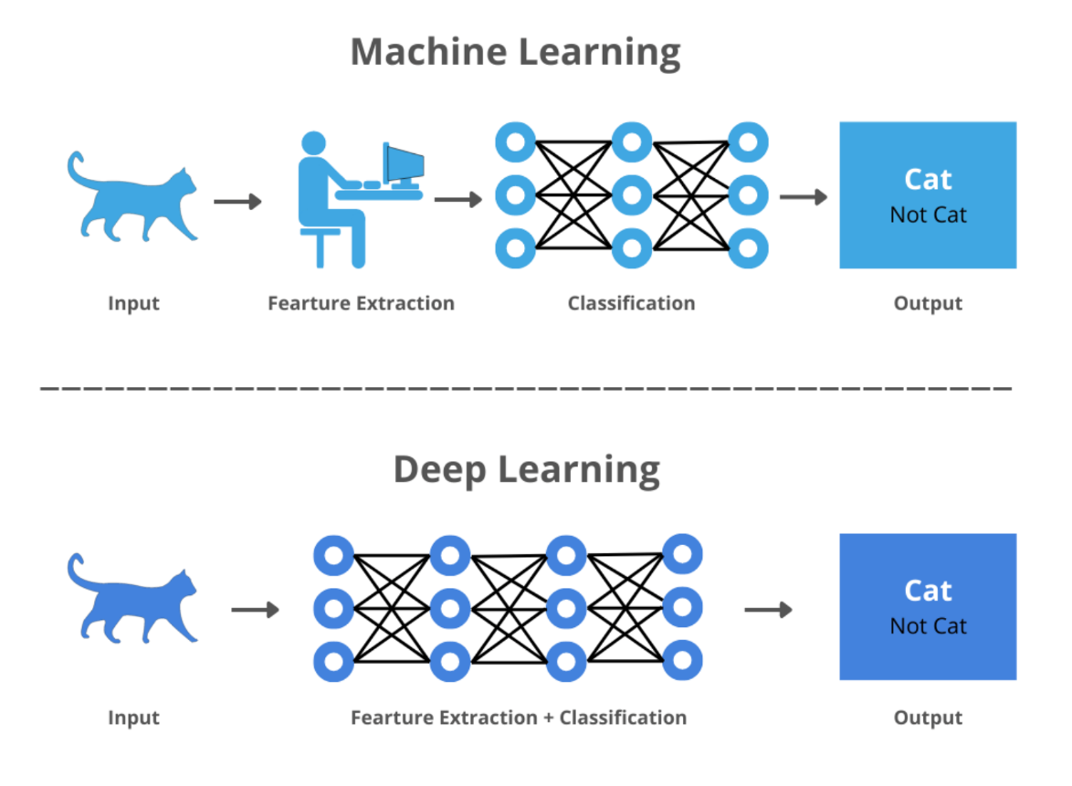
What Is Deep Learning?
Deep Learning is a subset of machine learning.
It uses neural networks with a large number of layers and parameters.
It excels at extracting meaningful patterns from large volumes of data drawn from diverse sources.
FIT1055: IT Professional Practice and Ethics | Week 6

Slide 35
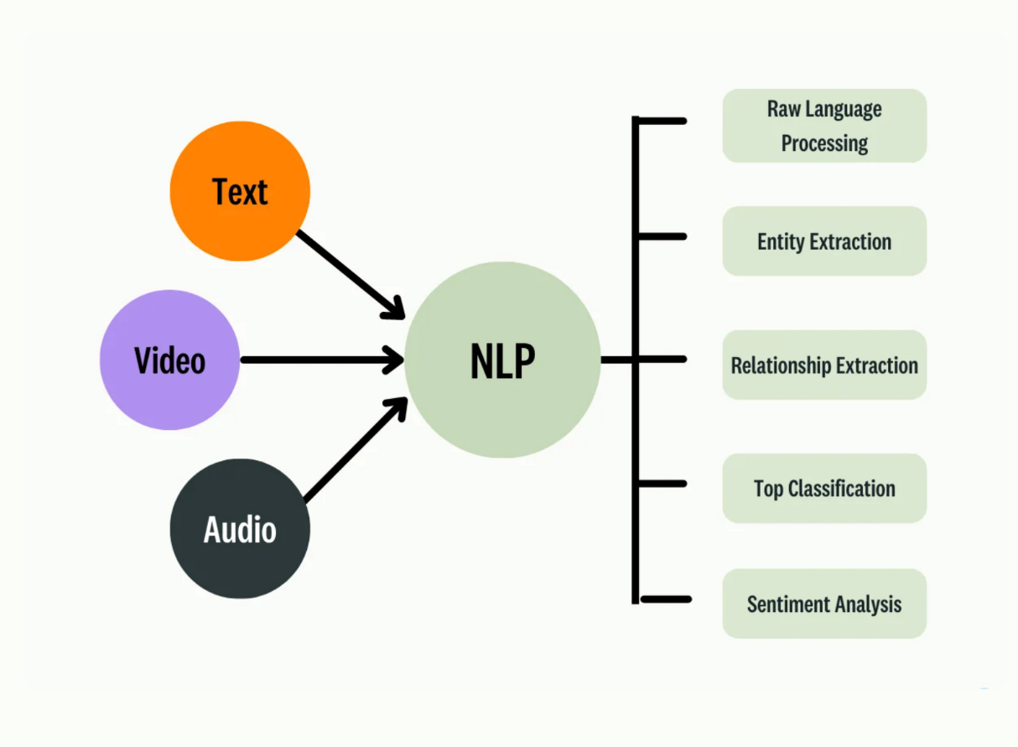
What Is Natural Language Processing (NLP)?
NLP is a branch of AI focused on enabling computers to understand, interpret, and work with human language.
Historically rule-based, NLP has evolved to incorporate machine learning and computational linguistics — the study of how language is structured and understood.
FIT1055: IT Professional Practice and Ethics | Week 6

Slide 36
Natural Language Processing (NLP) — Continued
At its core, NLP comprises two complementary capabilities: natural language understanding (human to machine) and natural language generation (machine to human).
It draws on syntax and semantic analysis to power chatbots and conversational agents capable of engaging in human-like dialogue.
FIT1055: IT Professional Practice and Ethics | Week 6

Slide 37
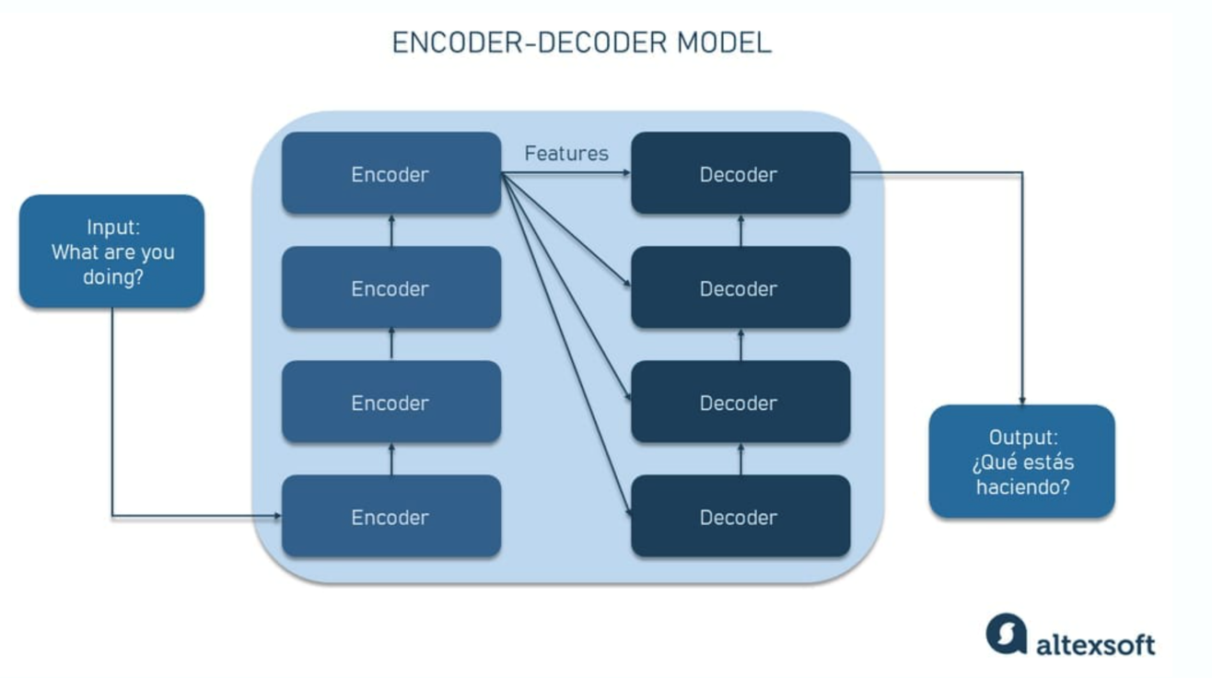
What Is Generative AI?
Generative AI builds on the foundations of NLP — moving beyond comprehension to actively producing new content
It uses large language models and deep learning to learn from, process, and generate new text, images, and audio — given a prompt or existing data
FIT1055: IT Professional Practice and Ethics | Week 6

Slide 38
Strengths and Limitations of Machine Learning
Strengths | Limitations
Learning capability — learns from data without constant reprogramming | Explainability — lacks transparency in how it reaches conclusions
Complex data — handles complex, unstructured big data effectively | Data acquisition — requires massive, inclusive, high-quality datasets
Pattern identification — discerns intricate trends in vast datasets | Bias — reflects biases in training data, skewing results accordingly
Accuracy — improves over time as it trains on new data | Time and cost — processing and training can take weeks, months, or years
FIT1055: IT Professional Practice and Ethics | Week 6

Slide 39
Part 4: Ethical Challenges in
the Use of AI
Where your code decisions have real consequences
FIT1055: IT Professional Practice and Ethics | Week 6

Slide 40
Real-World Complexity: Beyond Simple Rules
Modern Ethical Dilemmas You Will Face:
Algorithmic Bias: Your hiring algorithm performs well for male candidates but poorly for female candidates. What do you do?
Ship it as-is — it meets the technical requirements
Delay the launch to address the bias — at a cost to budget and schedule
Disclose the limitation to users — which may reduce adoption
FIT1055: IT Professional Practice and Ethics | Week 6

Slide 41
Where Ethical Issues Emerge in AI
1. Data Processing Problems
Search engines appear neutral but frequently encode gender stereotypes in their results
Translation tools frequently assume “doctor” = male and “nurse” = female
Example: Google Translate converting gender-neutral source languages into gendered English
2. Training Data Bias
Garbage In, Garbage Out — biased training data produces biased AI
Example: Facial recognition trained predominantly on lighter-skinned faces performs significantly worse on people with darker skin
Real Impact: Medical AI trained on data from one demographic may produce inaccurate results for others
FIT1055: IT Professional Practice and Ethics | Week 6

Slide 42
Where Ethical Issues Emerge in AI
3. Algorithmic Decision-Making
AI systems are making consequential decisions about loans, job applications, and criminal sentencing
Those affected often have no idea that an AI was involved, or how the decision was reached
FIT1055: IT Professional Practice and Ethics | Week 6

Slide 43
Real-World Examples You Should Know
Hiring Algorithms
What Happened: Amazon’s AI recruitment tool systematically down-ranked resumes containing the word “women” — including phrases like “women’s chess team”
Why: The model was trained on a decade of historically male-dominated hiring data
Lesson: Historical patterns of bias get directly encoded into AI systems
FIT1055: IT Professional Practice and Ethics | Week 6

Slide 44
Real-World Examples You Should Know
Criminal Justice AI
What Happened: The COMPAS system, used to predict reoffending risk, was found to exhibit significant racial bias
Why: Its training data reflected pre-existing inequalities within the criminal justice system
Impact: People’s freedom and futures were shaped by the outputs of a biased algorithm
Medical AI
What Happened: Pulse oximeters — widely used during COVID-19 — were found to be less accurate for patients with darker skin
Why: The devices had been calibrated primarily using data from lighter-skinned patients
Impact: This led to delayed or inadequate medical treatment for affected patients
FIT1055: IT Professional Practice and Ethics | Week 6

Slide 45
The Root Cause: Lack of Awareness
Why Do These Problems Keep Happening?
Professional Identity Crisis
Developers often see themselves as “just coders” rather than as decision-makers with societal influence
Reality: Every line of code embeds values, assumptions, and choices
Values Blindness
Developers are often unaware of their own biases and the assumptions built into their work
Example: Assuming the “default user” looks like — or shares the background of — the development team
FIT1055: IT Professional Practice and Ethics | Week 6

Slide 46
The Root Cause: Lack of Awareness
Why Do These Problems Keep Happening?
Systems Thinking Gap
Developers focus on technical requirements while ignoring broader social context
Missing: The understanding that algorithms operate within complex systems involving people, culture, law, and power
Decision-Making Deficit
Computing graduates are often not taught to think systematically about ethical implications
Result: Ethical thinking becomes reactive — responding to problems after they arise — rather than proactive
FIT1055: IT Professional Practice and Ethics | Week 6

Slide 47
The Challenge: Technology Changes Faster Than Rules
Traditional ethics codes were designed for a simpler era:
Clear-cut situations
Well-established practices
Predictable consequences
Modern AI and Algorithmic Challenges:
Machine learning systems make millions of decisions that are difficult or impossible to predict in advance
Algorithms affect people in ways we are still discovering
Ethical implications often only become apparent after deployment
Example: Is it ethical to deploy facial recognition for campus security when the system has higher error rates for certain ethnic groups?
FIT1055: IT Professional Practice and Ethics | Week 6

Slide 48
The Problem: When Codes of Ethics Aren’t Enough
What the ACM Code Does Well:
Helps practitioners identify ethical problems
Provides clear general principles to guide conduct
Illustrates what not to do
FIT1055: IT Professional Practice and Ethics | Week 6

Slide 49
The Problem: When Codes of Ethics Aren’t Enough
Where the ACM Code Falls Short:
It does not resolve conflicts between competing principles
It does not provide guidance on complex technical decisions
It cannot anticipate every new ethical challenge that emerging technology will create
This is why we introduce the Ethical Reasoning Framework in the next, Week 7 workshop.
FIT1055: IT Professional Practice and Ethics | Week 6

Slide 50
Part 5: What Does Ethical Use
of Algorithms Look Like?
Moving from problems to principles — what should ethical AI look like?
FIT1055: IT Professional Practice and Ethics | Week 6

Slide 51
Five Core Principles for Ethical Algorithms
1. Human, Societal, and Environmental Well-being
The Big Picture: AI systems should improve life for people, communities, and the planet
Example: Healthcare AI that improves diagnostic accuracy while minimising energy consumption
Your Role: Ask — does this technology genuinely make the world better?
FIT1055: IT Professional Practice and Ethics | Week 6

Slide 52
Five Core Principles for Ethical Algorithms
2. Human-Centred Values
The Big Picture: AI systems should uphold human rights, dignity, diversity, and individual autonomy
Example: Translation systems that honour cultural nuances rather than defaulting to Western norms
Your Role: Ask — does this system respect people’s fundamental rights and choices?
FIT1055: IT Professional Practice and Ethics | Week 6

Slide 53
Five Core Principles for Ethical Algorithms
3. Fairness and Inclusion
The Big Picture: AI systems should be accessible to all and avoid discriminating unfairly against any group
Example: Hiring algorithms that assess candidates equitably, regardless of gender, ethnicity, or background
Your Role: Ask — who might this system exclude or disadvantage?
FIT1055: IT Professional Practice and Ethics | Week 6

Slide 54
Five Core Principles for Ethical Algorithms
4. Privacy Protection and Security
The Big Picture: AI systems must protect personal information and maintain robust security
Example: Health apps that process data locally on the device rather than transmitting it to external servers
Your Role: Ask — how is personal data being collected, used, and safeguarded?
FIT1055: IT Professional Practice and Ethics | Week 6

Slide 55
Five Core Principles for Ethical Algorithms
5. Reliability and Safety
The Big Picture: AI systems must behave consistently, safely, and as intended
Example: Autonomous vehicles designed to fail safely and predictably in the event of a system malfunction
Your Role: Ask — what happens when this system gets it wrong?
FIT1055: IT Professional Practice and Ethics | Week 6

Slide 56
⚡ Week 6 Quiz
Ethical challenges in AI
FIT1055: IT Professional Practice and Ethics | Week 6

Slide 57
Summary
Software development is governed by professional guidelines spanning technical leadership, ethical conduct, and collaborative practice with fellow professionals.
AI development requires a rigorous ethical decision-making framework at every stage of system and algorithm design — ensuring innovation that is both responsible and principled.
FIT1055: IT Professional Practice and Ethics | Week 6

